Slide 1
Online Development Part Verification System
BY
TENNETI RAGHUSHARMA

Slide 2
Objective:
The project entitled “Online Development Part Verification system” deals with the various levels of project development and will account for time used in analysis, design programming, testing and verification, etc. It is well known fact that software companies under take huge projects more than one at a time. Hence there is a profound need for the organizations to manage all the projects efficiently and ensure that projects cycle goes on smoothly and they are completed on time.
During the lifetime of a project, the organization has to commemorate all the activities of the project. This tool makes it easier for the organization to monitor the projects. It maintains records and tracks various parameters that influence software project development process and helps the management to take decisions at various stages of the project development.

Slide 3
The product will assist the organization in maintaining record of every project it undertakes. All the information relevant to the projects like size, time, effort and departments involved, etc is maintained by this tool.
Masters is a place where we maintain the record of the entire projects undertaken, departments involved in the project and details of employees.
Transaction is the place where we carry out required operations with respect to parameters like size estimate, effort estimate.
Reports generated, for the operations we committed in the Reports module.

Slide 4
Existing System:
It is well known fact that software companies under take huge projects more than one at a time. Hence there is a profound need for the organizations to manage all the projects efficiently and ensure that projects cycle goes on smoothly and they are completed on time. During the lifetime of a project, the organization has to commemorate all the activities of the project. In this system they follow the manual process of maintaining records.

Slide 5
Problem Statement:
The project manager would be involved in creating detailed plan of the project and getting into the details of the delivery process. Several projects are in various stages at any point of time. Clients also insists on regular updates on progress of the project with details on which elements have been completed .The internal project manager find it difficult to have complete picture of the life cycle from the excel sheets they maintain on ongoing projects.

Slide 6
Proposed System:
It is well known fact that software companies under take huge projects more than one at a time. Hence there is a profound need for the organizations to manage all the projects efficiently and ensure that projects cycle goes on smoothly and they are completed on time. During the lifetime of a project, the organization has to commemorate all the activities of the project. This tool makes it easier for the organization to monitor the projects. It maintains records and tracks various parameters that influence software project development process and helps the management to take decisions at various stages of the project development.
The product will assist the organization in maintaining record of every project it undertakes. All the information relevant to the projects like size, time, effort and departments involved, etc is maintained by this tool.

Slide 7
Advantages:
This system maintains user’s personal, address, and contact details.
User friendliness is provided in the application with various controls provided by system rich user interface.
This system makes the overall project management much easier and flexible.
Various classes have been used for maintain the details of all the users and catalog.
The system also provides facilities to manage different projects and it’s sub modules online efficiently.
The system also provides facilities to manage project assignment to Team Leads by manager and sub module assignment to developers by Team leads.This system has also facility to manage different developer teams and their assignments to team leads.
This system is providing more memory for the users to maintain data.
This system is providing accessibility control to data with respect to users.
This system also maintains the user hierarchy.

Slide 8
Number of Modules:
The system after careful analysis has been identified to be
presented with the following modules:
Authentication and Security Module
Admin Module
Project Manager Module.
Employee Module.
Query and feedback Module.
Reports Module.

Slide 9
Authentication and Security Module
The user details should be verified against the details in the user tables and if it is valid user, they should be entered into the system. Once entered, based on the user type access to the different modules to be enabled / disabled and individual user can change their default password or old password.

Slide 10
Admin Module
This module consists of the following sub modules:
Registration Module
Here admin register new employees and store their details in database . He
also register new projects and store their details in database.
Users Management Module
Here admin manages different type of users. He can view/update their
details, can delete them if requirement comes. He also manages teams of
developers here and their assignment to team leads.
Project(Task) Management Module
Here admin can add a new project and can add , view, modify and delete
them according to requirement. Here admin also can assign this projects to
team leads.

Slide 11
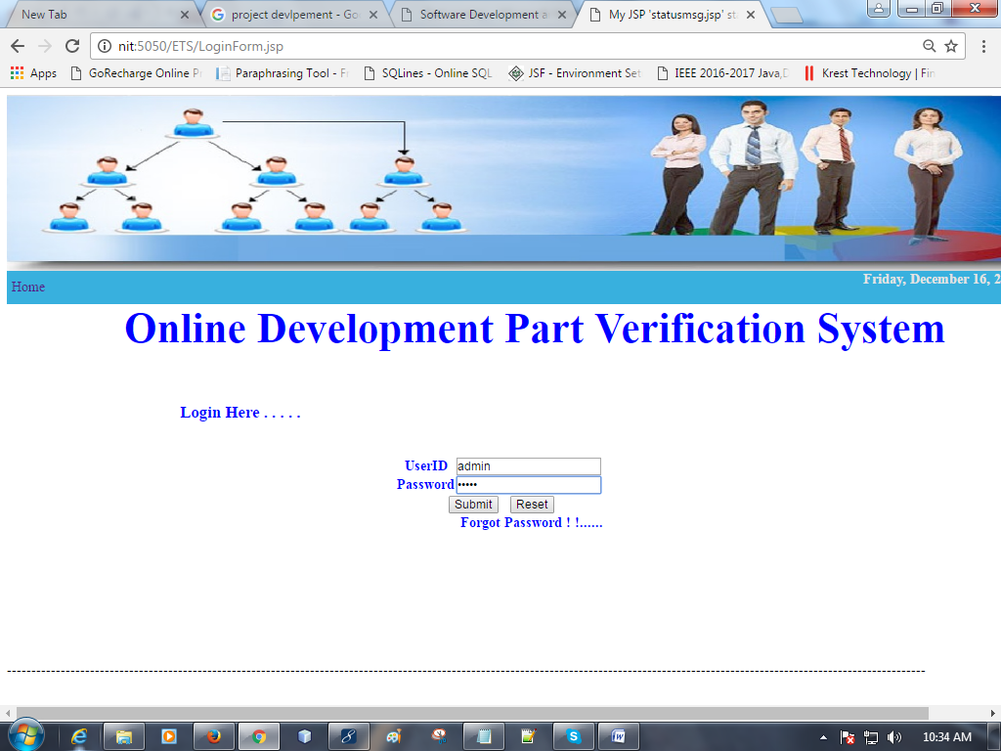

Slide 12
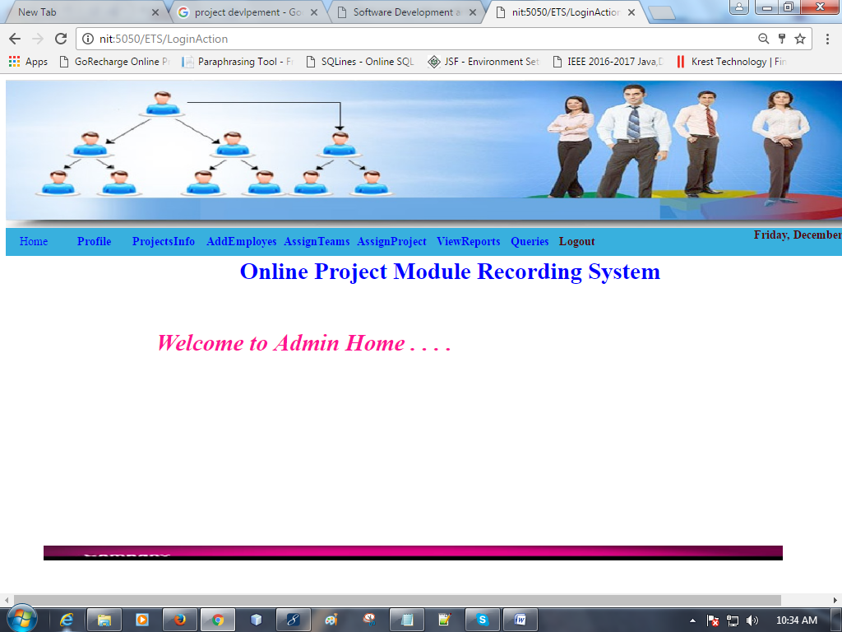

Slide 13
Project Manager Module
This module has following sub modules:
Project-Module Management Module:
Here team leads create sub modules of an assigned project. And
manages this according to requirement.

Slide 14
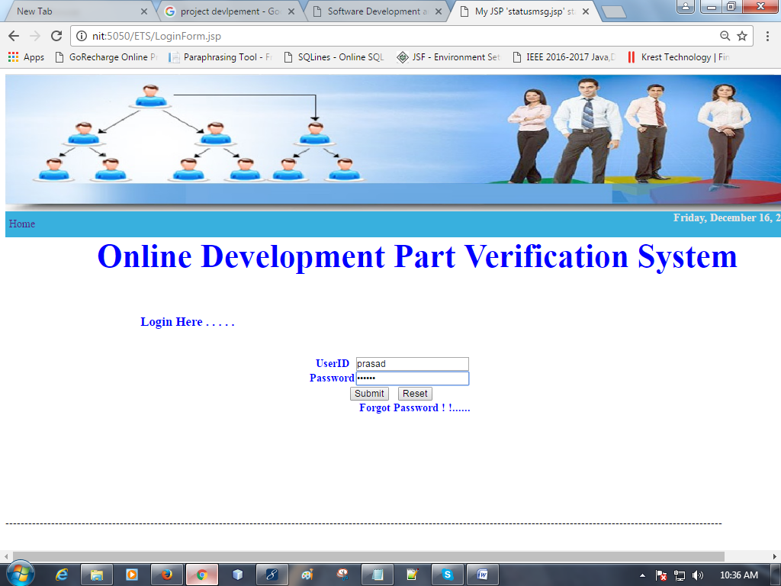

Slide 15
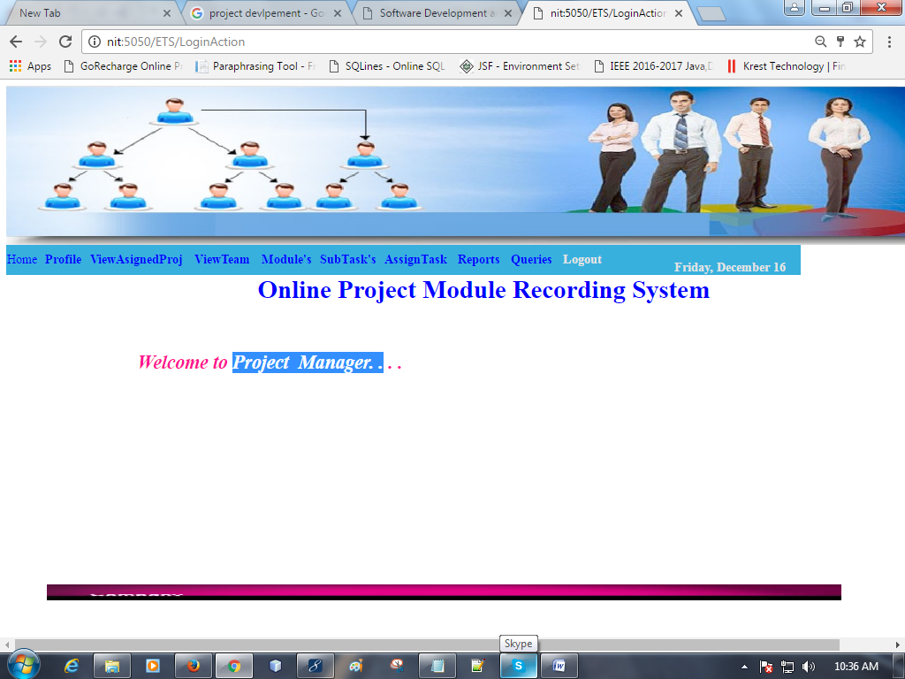

Slide 16
Employee Module:
Here Employee view the subtask assigned by the team lead and set the status means how much effort spent to the assigned the task. He can also able to send the queries to team lead or manager and view the reply.

Slide 17
Client Module
The Details of the project added by the client i.e project name ,allocate the project to the corresponding project manager.

Slide 18


Slide 19
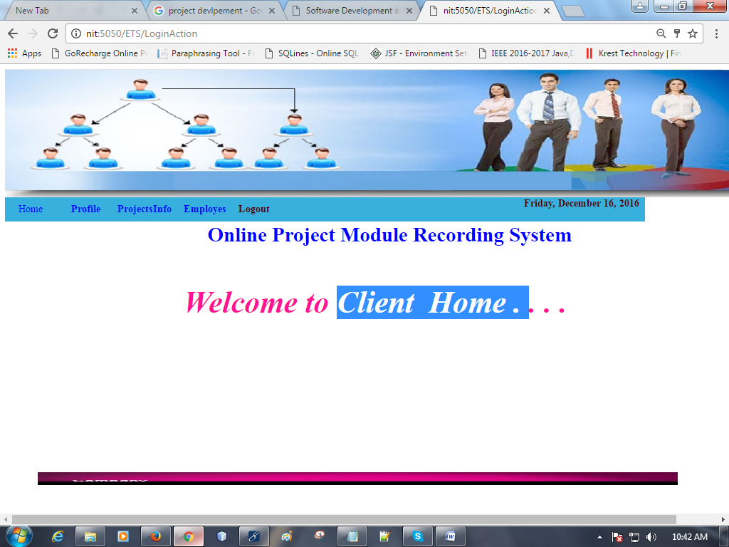

Slide 20
Query And Feedback Module:
Using this module the system maintains a query and feedback sub system in between users. An user can make a query to his superiors regarding any matter And an user can reply the queries made to him.

Slide 21
Reports Module:
In this Module the User and Administrator can generate the different types of Reports according to their access.

Slide 22
Software Requirements:
Operating System : Windows XP/2003/2007
User Interface : HTML, CSS
Client-side Scripting : JavaScript
Programming Language : Java
Web Applications : JDBC, Servlets, JSP
IDE/Workbench : My Eclipse 8.0
Database : Oracle 10g
Server Deployment : Tomcat 6.x

Slide 23
Hardware Requirements:
Processor : Pentium IV
Hard Disk : 40GB
RAM : 512MB or more

Slide 24
Conclusion:
This tool makes it easier for the organization to monitor the projects. It maintains records and tracks various parameters that influence software project development process and helps the management to take decisions at various stages of the project development.

Slide 25


